Slide 1
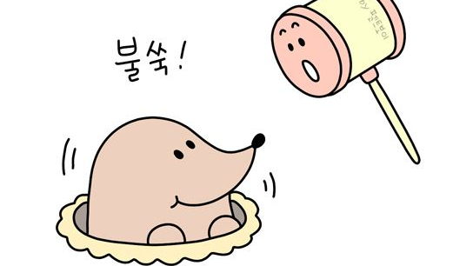
두더지잡기
권나래20182673
정호재20182745

Slide 2
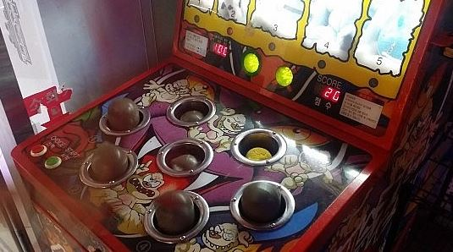
In 오락실

Slide 3


HOW TO PLAY
Using cursor, not hammer

Slide 4
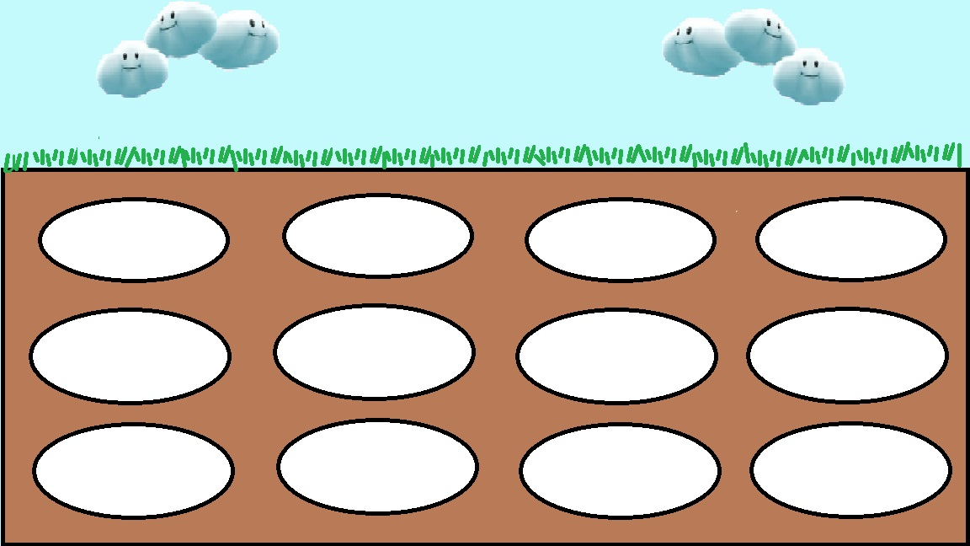
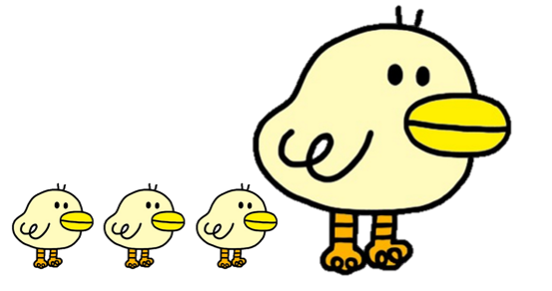
TO RECORD TIME

Slide 5
The GIST
void draw() {
background(0);
image(img, 0, 0, width, height);
image(byung, b_x, b_y, 80, 40);//byung size
fill(0);
textSize(30);
textAlign(CENTER);
text("score : " + score, width/2, 50);
drawDo();
randomSpawn();
time();
}
void time()
{
b_x = (int)map(millis(), current, current + endTime, 0, width);
if (current + endTime < millis())
{
gameOver();
}
}
void gameOver()
{
gameOver = true;
fill(#00FF4A);
textAlign(CENTER);
textSize(50);
text("score : " + score + "\nClick to start again", width/2, height/2);
noLoop();

Slide 6
drawDo();
void drawDo()
{
for (int i = 0; i < doS.length; i++)
{
int xTemp = 40 + 283 * (i%4);
int yTemp = 216 + 140 * (i/4);
if (doS[i])
{
image(doodle, xTemp, yTemp- 180, 250, 375);
} else
{
image(ugly, xTemp, yTemp, 250, 150);
}
}
}

Slide 7
randomSpawn()
{
if (spawnTimer + interval < millis())
{
for(int i = 0; i < doS.length; i++)
{
if(doS[i])
{
doS[i] = false;
}
}
for (int i = 0; i < 3; i++) //spawn number
{
int temp = (int) random(0, 12);
doS[temp] = true;
}
spawnTimer = millis();
}
}

Slide 8
void mousePressed()
void mousePressed()
{
for (int i = doS.length - 1; i >= 0; i--)
{
int xTemp = 40 + 283 * (i%4);
int yTemp = 216 + 140 * (i/4);
if (mouseX > xTemp&&mouseX < xTemp + 250 && mouseY > yTemp - 100 && mouseY < yTemp + 125)
{
if (doS[i])
{
doS[i] = false;
score++;
break;

Slide 9
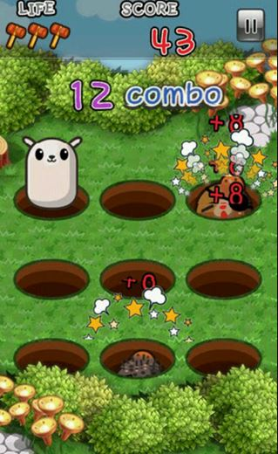
Make game for smartphone

